Slide 1


An Interactive 3D Virtual Anatomy Puzzle for Learning and Simulation — Initial Demonstration and Evaluation
Erik MESSIER ^{a,1}, Jascha WILCOX ª, Gabriel DIAZ ^{b}, and Cristian A. LINTE ^{a,b}
ªKate Gleason College of Engineering, ^{b}Chester F. Carlson Center for Imaging Science, Rochester Institute of Technology, Rochester, NY, USA
2016 Medicine Meets Virtual Reality
Las Angeles CA USA

Slide 2
Why a 3D Virtual Anatomy Puzzle Game?
Anatomy is implicitly 3D, yet ubiquitously taught in 2D
We live in the “digital era” and 3D, 4D , and 5D medical images are abundant
There is a growing market for 3D visualization displays

Slide 3
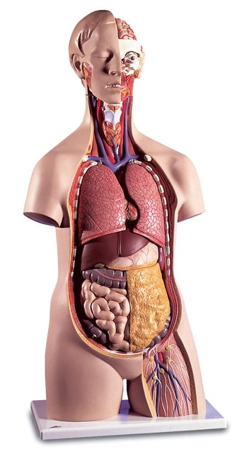
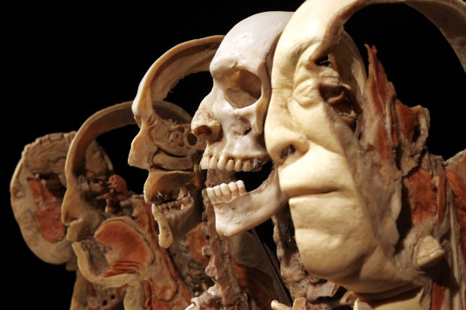
Anatomy is Implicitly 3D
Conventional 3D didactic tools are limited, are generally costly, and/or require appropriate infrastructure.
2016 STLtoday.com
3B Scientific 2016 c
Notes:
Image from 2016 body world exhibit in St. Louis. Pictured is the “Sagittal 3D Slice Body”.

Slide 4
Abundant 3D, 4D, and 5D Medical Images
Open Source:
Visible Human Project
BodyParts3D
OsiriX
Proprietary:
ZygoteBodyTM Dataset
Mimics
Pacific Research Laboratories
Notes:
OsiriX is an open source program for viewing medical datasets such as CT and MRI scans, and it is possible to extract 3D structures in a format that can be used for engineering.
Mimics: Mimics is an image processing software for 3D design and modeling, developed by Materialise NV.

Slide 5
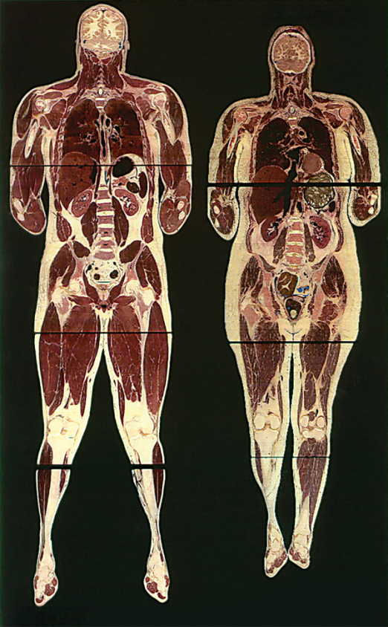
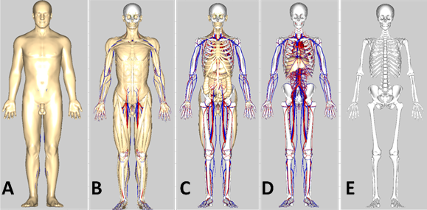
Abundant 3D, 4D, and 5D Medical Images
BodyParts3D
National Library of Medicine
Notes:
The visible human: Computed Tomography (CT), Magnetic resonance Imaging (MRI), as well as digital histology slices. Can produce 3D models through manual or automatic segmentation techniques, or volume rendered segmentation techniques.

Slide 6
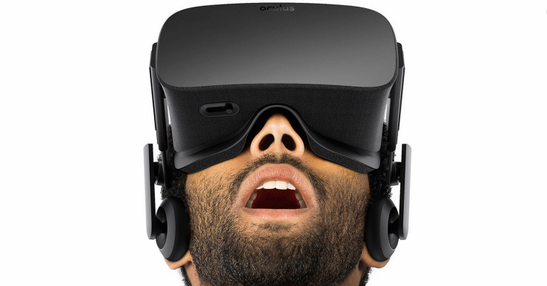
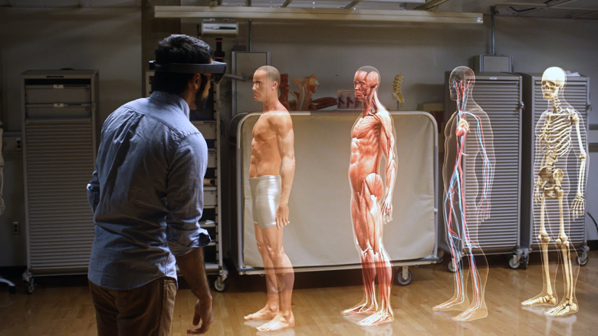
New Stereoscopic Displays
Head Mounted Virtual Reality Displays
Oculus Rift
Sony PlayStation VR
HTC Vive
Samsung Gear VR
Microsoft HoloLens
Google Cardboard
2013-2016 AOL Inc.
2016 Microsoft

Slide 7
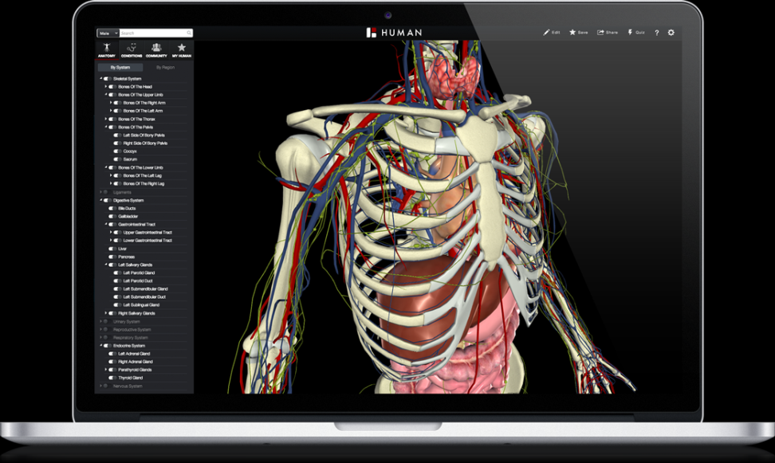
Current Work in the Field
There are solutions to the limited number of easily accessible 3D didactic tools in anatomical education.
ZygoteBodyTM
The BioDigital Human
Cyber Anatomy
Essential Anatomy
2016 BIODIGITAL, INC.
Notes:
Biodigital Human:
- Simulated anatomy and diseases. Animations of systems interactions. Free and can be run from the browser. Very in depth dataset.

Slide 8

Again, Why a 3D Virtual Anatomy Puzzle Game?
To create a 3D didactic tool for anatomy that:
Utilizes open source, high quality, anatomical models
Explores the utility of virtual reality in 3D visualization
Virtual

Slide 9
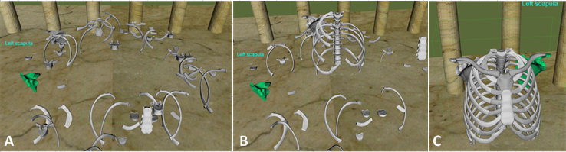
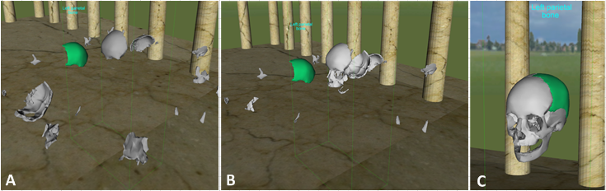
Proposed Game
The task of the user is to reconstruct 3D anatomical structures from randomly selected “keystones”
Game Modes:
Free Play Mode
Quiz Mode
Interface Tutorial
Above: Thorax assembly in Free Play Mode.
Below: Skull assembly in Free Play Mode.

Slide 10
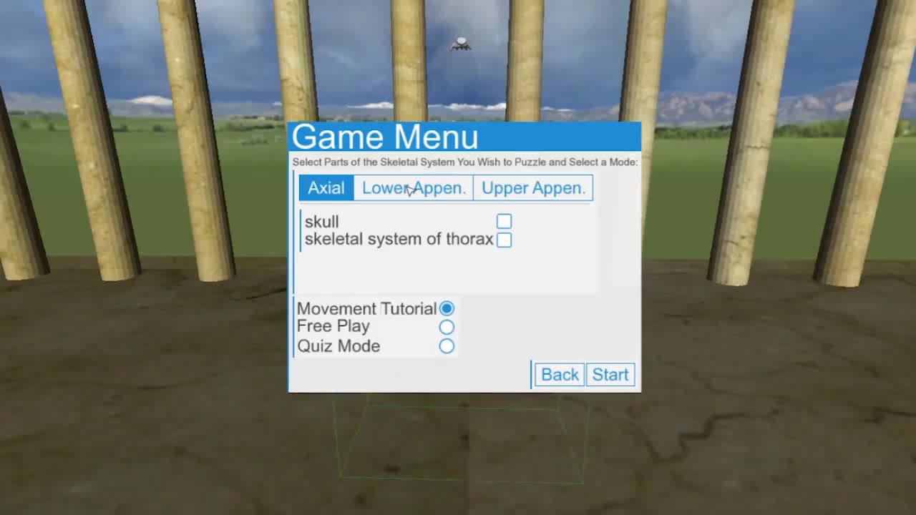
Free Play/ Quiz Modes

Slide 11
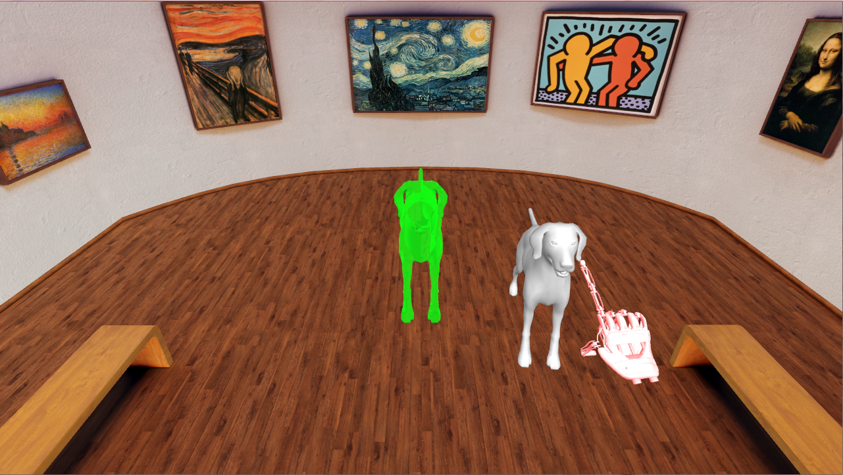
Interface Tutorial

Slide 12
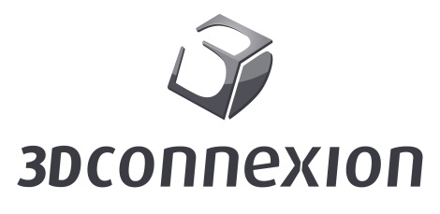



Platform Architecture
Software Platform
WorldViz Vizard Toolkit
Python
Dataset
BodyParts3D
Display Modalities
Traditional 2D Computer Monitor
Oculus Rift DK1/2
Input Devices
Keyboard Map
3DConnexion SpaceMouse

Slide 13
Evaluation of Game
Procedure:
Subjects completed written fill-in-the-blank entrance exam to assess baseline knowledge.
Interface Tutorial was played 4 times with all combinations of input/display modality.
Anatomy puzzle game was played 3 times (using SpaceMouse and Oculus Rift)
1 play-through of desired anatomy in Free Play Mode
2 play-throughs of same desired anatomy in Quiz Mode
Another full factorial of input/display modalities in Interface Tutorial
Subjects completed the same fill-in-the-blank exit exam
Subjects completed comfort questionnaire

Slide 14
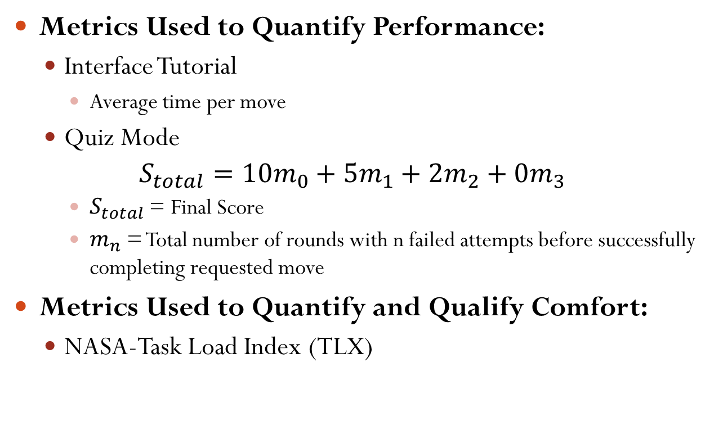
Evaluation of Game
Metrics Used to Quantify Performance:
Interface Tutorial
Average time per move
Quiz Mode
$$S_{total}=10m_{0}+5m_{1}+2m_{2}+0m_{3}$$
$S_{total}$ = Final Score
$m_{n}$ = Total number of rounds with n failed attempts before successfully completing requested move
Metrics Used to Quantify and Qualify Comfort:
NASA-Task Load Index (TLX)

Slide 15
Goals of Evaluation
Quantify/Qualify the users’ comfort level with the interface and display technology
Quantify/Qualify the effect of training on input/display modalities
Quantify the effect of training associated with the Puzzle Game on the subject’s knowledgebase of tested anatomy

Slide 16


Results
2 subjects were tested
Both subjects were at the collegiate level
Neither subject had much experience with either the Oculus Rift or SpaceMouse
Neither subject had a background in Anatomy, or related fields
Subject 1 was a non-native English speaker
Both subjects were tested using the skull
Maximum score in Quiz Mode was 200
Subject 1
Subject 2

Slide 17
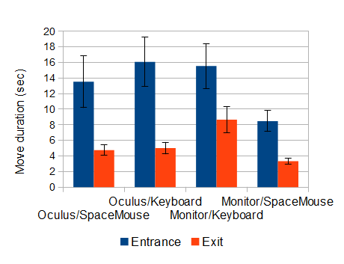
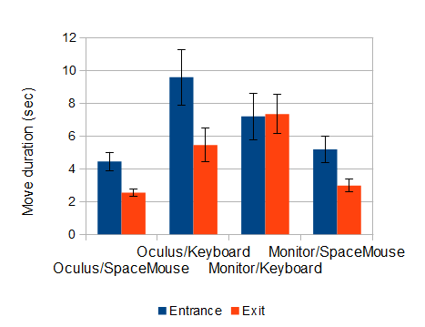
Results: Input/Display Test
Subject 1
Subject 2

Slide 18
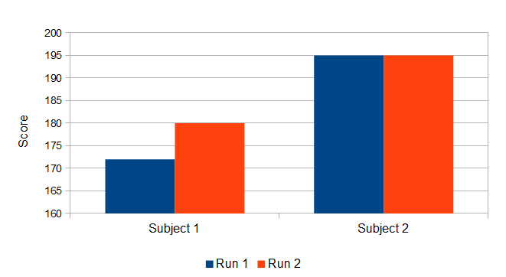
Results: Learning

Slide 19
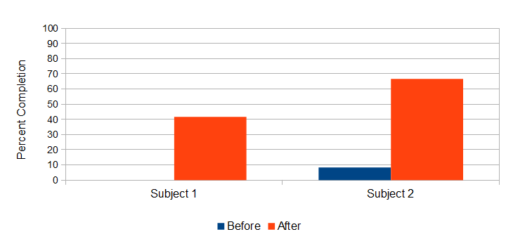
Results: Learning

Slide 20
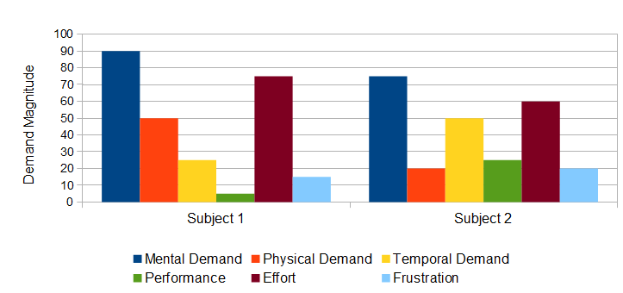
Results: Comfort Level

Slide 21

Conclusions
Subjects Learned!
Both subjects rated their experience with high Mental Demand and Effort
Both subjects preformed much better with each input/display combination at the end of the test

Slide 22

Future Work
Expand the study
More subjects
Include more standardized measurements and evaluations
Fitt’s Law
Expand usable portion of the dataset
Make new game modes
Revisit game mechanics
Subjects reported slight discomfort when playing the game with the Oculus because of the mechanics
Outreach program
Work with students in K-12 to stimulate interest in anatomy, bio-engineering, medical imaging, etc.

Slide 23
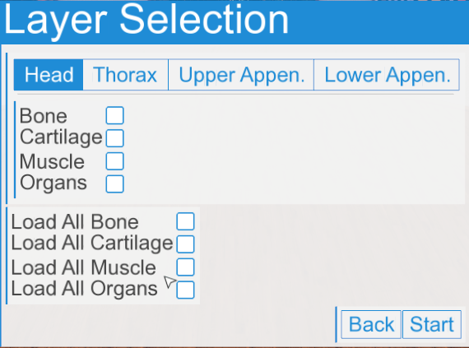
Since the Study Was Performed

Slide 24
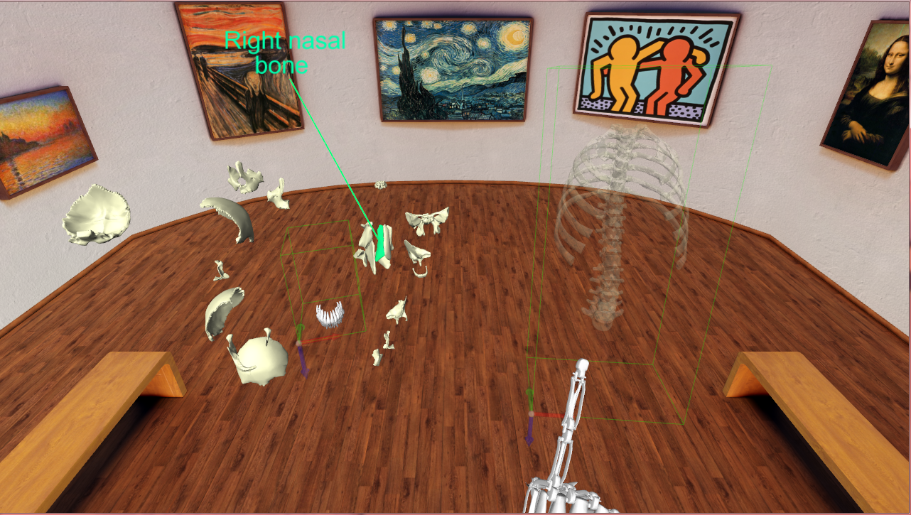
Since the Study Was Performed

Slide 25
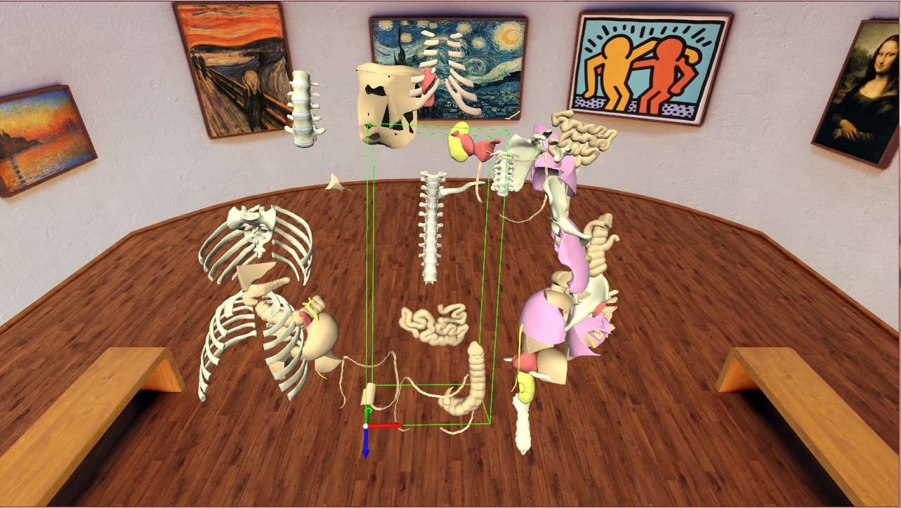
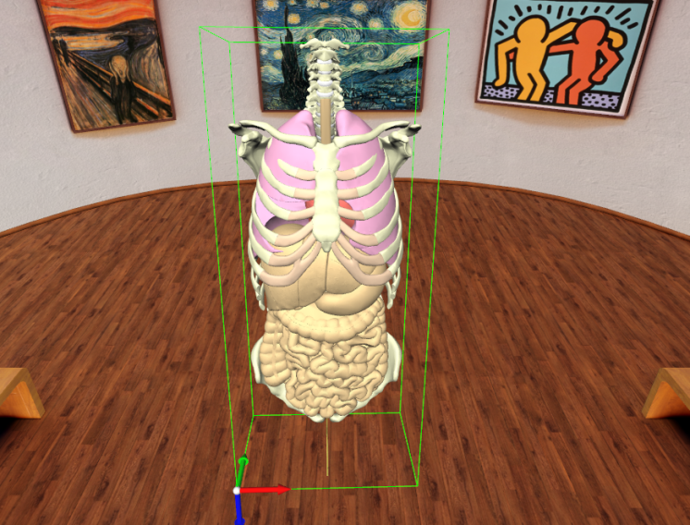
Since the Study Was Performed

Slide 26











Acknowledgements
Biomedical Modeling, Visualization & Image-guided Navigation Group
Funding Support
Alex Bensch
Aditya Daryanani
Dylan Dang
Shusil Dangi
Alex Dawson-Elli
Mia Garbaccio
Kevin Alexandre
Amy Hughes
Michael Kormos
Michael Potter
Caroline Trier
Zhenlin Xu
Kenneth la Marca
Nathan Burrell
Collaborators

Slide 27
Thank You!
Erik MESSIER ^{a,1}, Jascha WILCOX ª, Gabriel DIAZ ^{b}, and Cristian A. LINTE ^{a,b}
ªKate Gleason College of Engineering, ^{b}Chester F. Carlson Center for Imaging Science, Rochester Institute of Technology, Rochester, NY, USA
2016 Medicine Meets Virtual Reality
Las Angeles CA USA

